Slide 1
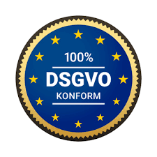








Orange Cyberdefense
  Certificates & Accreditations
Worldwide
Security Revenue 2024
approx. 1.2 billion €
Part of Orange S.A.
approx. €44 billion
17 SOC’s
11 CERT’s
4 Scrubbing Centers
ISO 27001
ISO 9001
ISO 14001
CERT Competencies
24/7/365
MSS Services
Continuous monitoring of
safety-relevant systems
Incident response with on-site support
50,000
Customers worldwide
40,000
Suspicious websites closed every year
~500
Sources for our
Threat Intelligence Datalake
3.100+
Highly qualified cybersecurity experts
1.000
Security Consultants
SOC2 Type II
audited
Qualified APT response service provider at the BSI

Slide 2
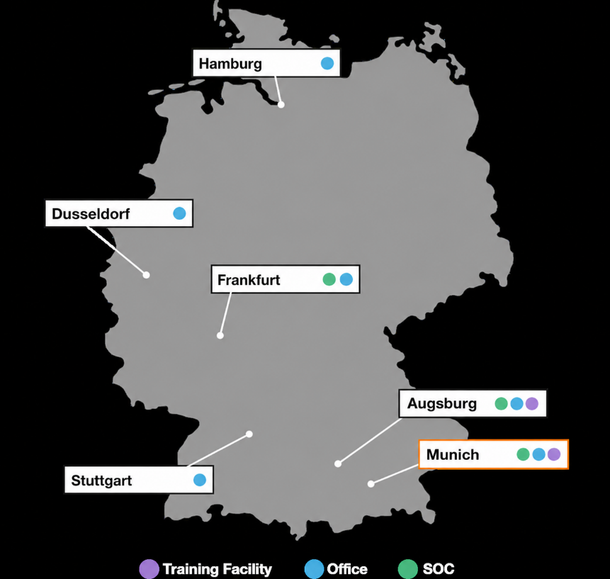

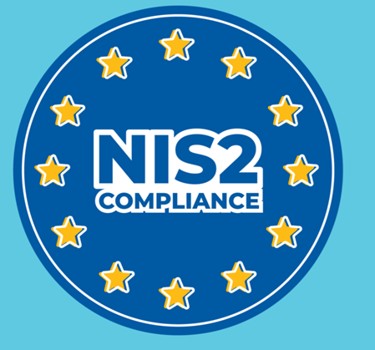


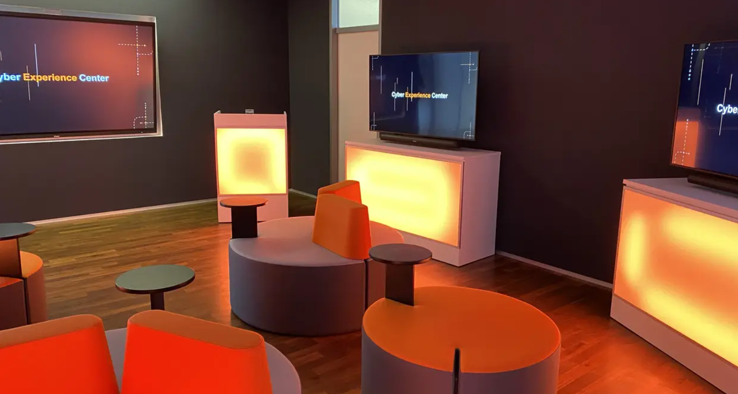
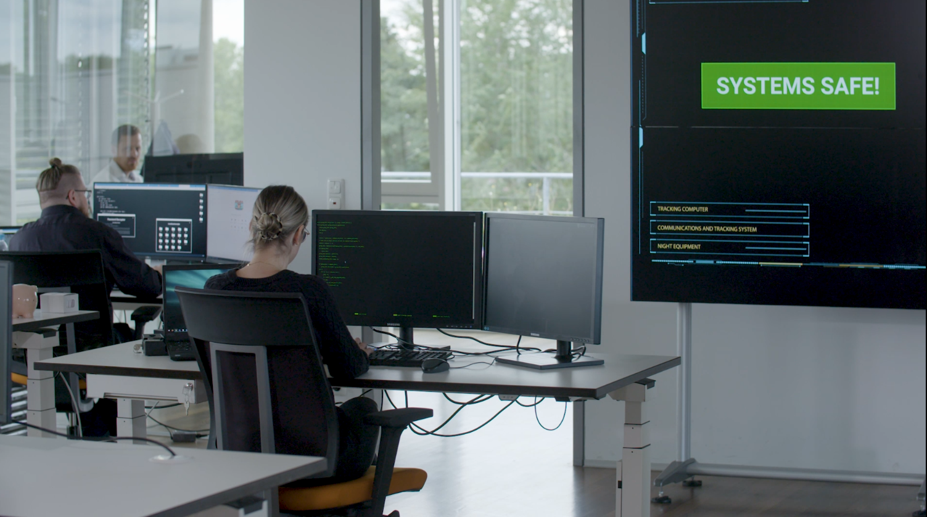
Orange Cyberdefense in Germany
Your consulting and service partner with AI and compliance know-how
50 Security Consultants
AI-optimized managed detection and response for IT and OT
Vulnerability, Threat and Exposure Management
Infrastructure Transformation
Data Loss Prevention
80 regional MSS experts
in German-speaking 24x7 SOC
New in Augsburg
  Cyber Crisis Management & Analysts Training

Slide 3
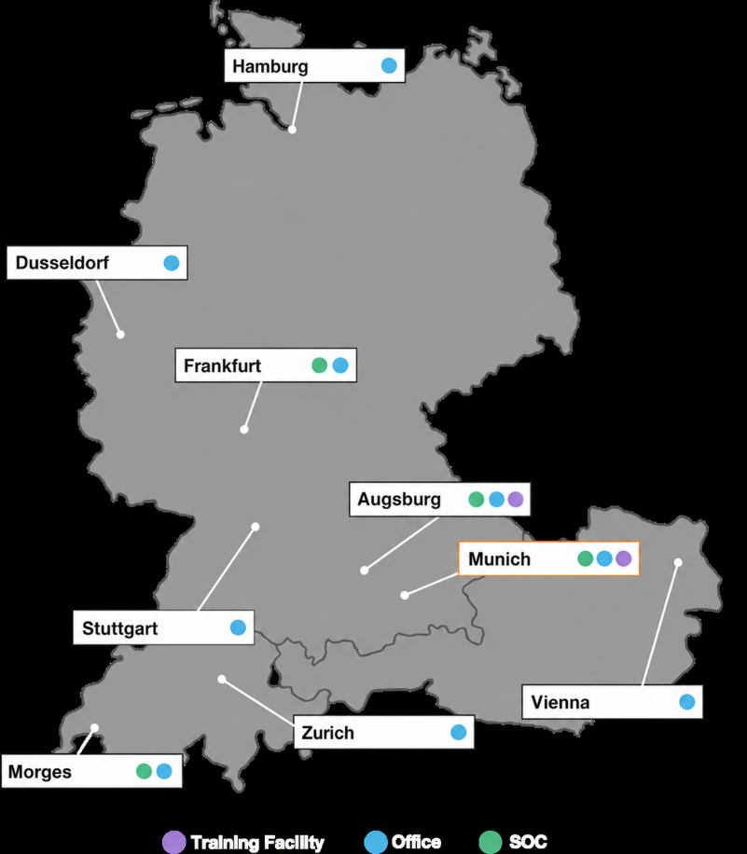
Orange Cyberdefense in D/A/CH
Your consulting and service partner with AI and compliance know-how
50 Security Consultants
AI-optimized managed detection and response for IT and OT
Vulnerability, Threat and Exposure Management
Infrastructure Transformation
Data Loss Prevention
80 regional MSS experts
in German-speaking 24x7 SOC
NEU in Augsburg
  Cyber Crisis Management & Analysts Training

Slide 4
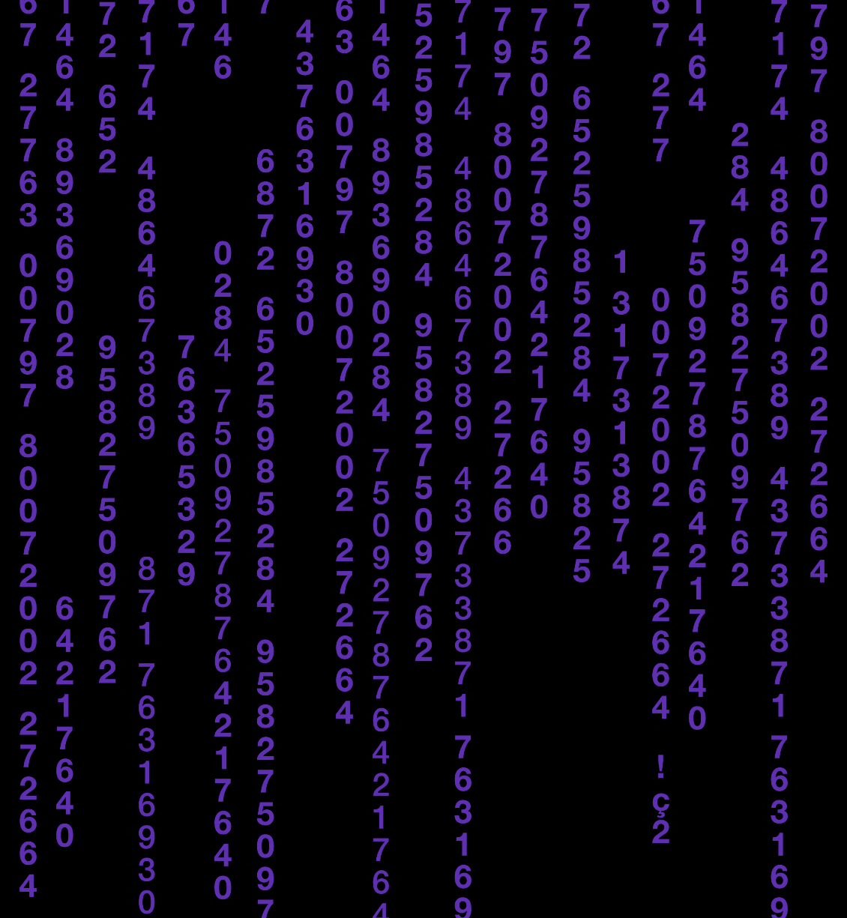
Why Orange Cyberdefense?
Our strengths and unique capabilities.
Global presence with European roots.
Threat Research & Intelligence is part of our DNA.
3,000+ cybersecurity experts work together.
You're protected and compliant no matter where you are.
You can concentrate on what matters and achieve better results.
You can focus on your business and create a trusted digital space.
Notes:
Why us? How we do it?
We are a European anchorage with a global footprint: you are protected and compliant no matter where you are located.
Threat research & intelligence is part of our DNA: so you can focus on what matters, achieving better security outcomes.
2,500+ cybersecurity experts working together: so you can focus on your business, enabling a trusted digital space.

Slide 5
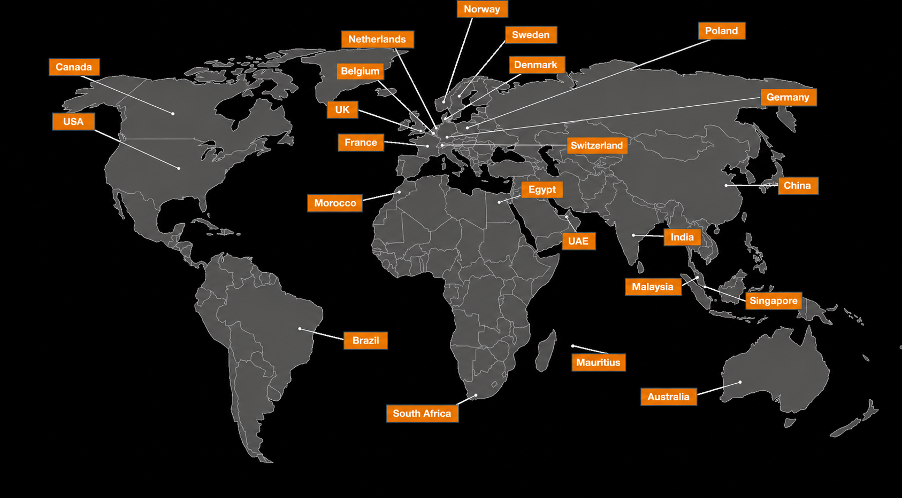
We speak your language.
Notes:
Global protection with local expertise. We offer you 24/7/365 local operations in 19 locations with 18 Security Operations Centres (SOCs) worldwide, 11 CyberSOCs, 4 CERTS and sales and services support in 160 countries. This means we thoroughly understand local regulations, context and speak your language while protecting your business globally.
Our SOCs and CyberSOCs track malicious actors’ campaigns across regions and time zones, helping your business be constantly aware of emerging threats and quickly support remediation in case of an incident.

Slide 6
Cybersecurity Intelligence
Internal and external data are collected, validated, aggregated, correlated and analyzed.
Risks and threat actors are identified, attacks are detected and the motivations, methods and actions of the attackers are understood.
Limited security resources can be invested where they have the greatest impact.

Slide 7





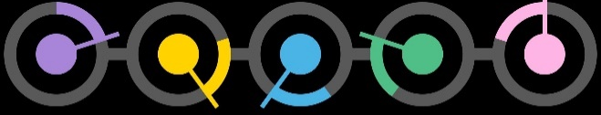
We support you throughout the entire threat lifecycle.
Anticipate
Anticipate the latest cyber threats and prevent digital risks.
Identify
Identify your critical assets, data, and vulnerabilities to define your security strategy and actions.
Industry expertise
Protect
Protect your business with the right technology and expertise.
Tailor-made services
Detect
Detect cyber attacks by analyzing alarms and behaviors.
Technology
Consulting
Management
& Support
Respond
Respond to cyber attacks with appropriate mitigation and remediation plans.
Notes:
So let me try and explain why this report is important for our managed services sales and how also how our managed services can help our customers.
If we start with the customer. Customer decision-making is done in the same part of the brain as where they have their feelings. So feelings will control decitions.
The most important feeling for us is “TRUST”, and this report really help to buld trust for us and our abilities with our customers.
So how can we help our customers where they may fall short? Lets look at this within the context of our five different services areas.
ANTICIPATE: If you do not understand the threat, how can understand how to identify, detect or protect against the threat?
Do you have resources and skils to monitor for new vulnerabilities, threats (like fake domains, mobile apps) or attackvectors like java-scripr card skimming…) If not, buy a service
IDENTIFY: Always a good idea to have an external thirdparty to verify your attack surface. We know of customers that have excluded vuln data to look better in their internal KPI:s..
PROTECT: A big part of incidents could have been avoided, or the impact could have been reduced if the equipment where configured in an optimal way. Do customer have time and deep expertise across all the
complex cybersecurity technologies to be able to configure and monitor them in an optimal way
DETECT: Detection has three challenges:
1.) There is no silver bullet (log vs endpoint vs network) You need to understand how to best invest your money to get ROI
2.) Analyzing detections are more complex today than 10 years ago. Then it was black/white. Hit/miss based on signatures and static correlation rules Now it is all about detecting behavior anomalies in files, endpoint, application or network activities. You need to be an expert to be able to sort out the FP from the TP.
3.). This is not a daytime job. You need this 24x7
RESPOND:
The toughest job in the cybersecurity industry. If you do it 99.999% correct you have failed and the attacker is still in your infrastructure.
Threat Disruption requires 24x7 eyes-on-screen, and IR requires deep expertise and experience..

Slide 8

A holistic portfolio and experience to enable your business.
Threat Advisory Service
Managed Threat Detection - Intelligence
  Data Leakage Detection
  Brand Protection
  Attack Surface Reduction
Cyberwatch
Assessment Services
Advisory Services
Security Awareness Training
Penetration testing
Red and purple teaming
DevSecOps
Data-centric Security
Infrastructure Security
Network Security
Security Intelligence
Endpoint Security
Identity & Access Management
Managed Vulnerability Scanning
Managed Threat Detection
  Log based (SIEM)
  Network based
  Endpoint based
Incident response
  Retainer
  Emergency Response
  Incident Response Consulting
Digital forensics
Malware Analysis
Endpoint Quarantine

Slide 9
Cybersecurity Intelligence
Anticipate
World Watch Threat Advisory
Managed Cybercrime Monitoring
Cyber Threats
Identify
Assessment and Advisory Services
Managed Vulnerability Intelligence
Ethical Hacking
Risks before hackers do
Protect
Your business with the right technology
Managed Security Services – Endpoint, Network, Gateway, Identity Access, Vulnerability
Intelligence Backbone
Detect
Cyberattacks through the analysis of alarms
Managed Threat Detection – Endpoint, Network, Log based
Respond
with targeted investigation and response
Onsite Incident Response & Consulting
Compromise Assessment
Digital Forensics
Endpoint Quarantine
Notes:
Übersetzen
Siehe Email
With our operational and tactical focus, you have access to real-time intelligence to fend-of threats and mitigate vulnerabilities. Our services feed from our intelligence backbone, so you can adopt timely preventative measures, improve threat detection and targeted remediation.
<Highlight any service category or solution that fits for this customer>

Slide 10





Intelligence-led Managed Services
Threat & Vulnerability Intelligence
Orange
Global Threat Research Team
Managed Vulnerability Intelligence
[watch]
Anticipate
World Watch
Attack Surface Discovery
Threat Detection
Managed Vulnerability Intelligence
[identify]
Managed Cloud Security [infrastructure]
Ethical Hacking
Managed Cybercrime Monitoring
Malware Cleaner
Managed Threat Detection
[endpoint]
[log]
[network]
Identify
Detect
Attack Surface Reduction
Secure Infrastructure
Endpoint & Mobile Security
Identity & Access Management
Cloud & Application Security
OT / ICS Security
Protect
Incident Response
Respond

Slide 11
Attack Surface Reduction
Secure Infrastructure
Endpoint & Mobile Security
Identity & Access Management
Managed Firewall
(FSP)
Managed Secure Web Gateway
(WPS)
Managed Remote Access
(Flexible Application Access)
Managed WAF
(WAGO)
Cloud & Application Security
Managed Mobile Protection
(Mobile Threat Protection)
OT / IoT Security
Managed IAM
(Flexible Identity Authentication)
Managed Email Protection
(EPS)
Managed Endpoint Security
(SecurePrevent Endpoint)
Managed OT Firewall
Managed Cloud Firewall
(Secure Gateway)
Managed IDPS
(Active Prevention)
Managed OT Security
Managed DDoS Protection
Managed Firewall
(Secure Gateway)
Managed Cloud Security – Infrastructure
Protect

Slide 12
Intelligence-led Managed Services
Threat & Vulnerability Intelligence
Orange
Global Threat Research Team
Observations
Managed Vulnerability Intelligence
[watch]
Anticipate
World Watch
Managed
Vulnerability
Services
Attack Surface Discovery
Threat Detection
Managed Vulnerability Intelligence
[identify]
Managed Cloud Security [infrastructure]
Ethical Hacking
Managed Cybercrime Monitoring
Malware Cleaner
Managed Threat Detection
[endpoint]
[log]
[network]
Identify
Detect
Attack Surface Reduction
Managed
Detection &
Response
Services
Secure Infrastructure
Endpoint & Mobile Security
Identity & Access Management
Cloud & Application Security
OT / ICS Security
Protect
Incident Response
Incident Response Retainer / Emergency
Compromise Assessment
IR Consulting & Digital Forensics
Managed Threat Response
[isolation]
[takedown]
Respond

Slide 13
Service & Solution Domains
Security Intelligence
Secure Infrastructure & Endpoint Security
Cloud & Data-centric Security
OT/ICS Security
Consulting Germany
Strategy
Advise & Architect
Professional Services
Design & Implement
Operate, Test & Support
Near SOC
Detect & Respond
Managed Detection & Response Services

Slide 14
Service & Solution Domains
Security Intelligence
Secure Infrastructure & Endpoint Security
Cloud & Data-centric Security
OT/ICS Security
Consulting Germany
Strategy
Consulting & Conception
CISO as a Service
Cloud Security Maturity Assessment
Advise & Architect
Advisory Services
Assessment Services
Security Maturity Assessment
Professional Services
Solution Design
Review & Optimization
Threat Intelligence
Design & Implement
SIEM
SOC Toolstack
EDR
Cloud Security Posture Management
SOAR
Cloud Workload Protection Management
Use Case Design &
Implementation
Pentesting
DevSecOps
Operate, Test & Support
Operate SOC Toolstack
Vulnerablility Assessment
Code Review
Near SOC
SOC & Cyberdefense Center Consulting
Analyst Trainings
Cloud Monitoring
Industrial SOC
Detect & Respond
SOC Validation &
Optimization
Analyst as a Service
Cloud Workload Protection
Managed Detection & Response Services

Slide 15





Portfolio dedicated to Security Intelligence
Security
Consulting
Professional Services
Operate SOC Toolstack
SI
Security Solutions
SOC & SIEM Development
SIEM Architecture Planning
SOC Maturity Assessments
Cloud Security Monitoring Strategy
Use Case Consulting
Training / Workshops
Implementation – SIEM / SOAR
SIEM Migration
SIEM Cloud Integration
Copilot Service for Customers for Know How Transfer
Integrating SOC Toolstack
Operations
  Update & Maintain
  Data Onboarding
  Support & Troubleshoot
SIEM & SOAR
  Use Case Engineering
  Playbook Development
Develop Operation Concepts
SIEM
SOAR
Vulnerability Management
Threat Intelligence
Big Data Solutions
User Behavior Analytics
Machine Learning & Analytics

Slide 16

Portfolio dedicated to Infrastructure Security
Security
Consulting
Security
Solutions
Security
Solutions
Operate SOC Toolstack
Security Architecture & Design
Zoning Concepts
Cloud Integrations & Interoperability
Configuration Review
Analysis
Next Generation Firewalls
Secure Access Service Edge
Data Protection
Threat Prevention
Security Intelligence
Access Control
Secure Remote Access
Application Control
Endpoint Detection & Response
SD-WAN, Software Defined Network
Microsegmenation
Zoning Concepts
Pentests
Analysis
Integrating Infrastructure Security to SOC Toolstack
Operations
  Update & Maintain
  Data Onboarding
  Support & Troubleshoot
Use Case Engineering
Playbook Development

Slide 17
Portfolio dedicated to Endpoint Security
Security
Consulting
Endpoint
Security Solutions
Security
Solutions
Operate SOC Toolstack
Security Architecture & Design
Zoning Concepts
Configuration Review
Requirement Analysis
Incident Response
Endpoint Forensics
Next Generation Endpoint Detection & Response
Data Protection
Threat Prevention
Security Intelligence
Access Control
Secure Remote Access
Remote Forensics
Application Control
Microsegmentation
Authentication
NAC
Integrating EDR to SOC Toolstack
Operations
  Update & Maintain
  Data Onboarding
  Support & Troubleshoot
Use Case Engineering
Playbook Development

Slide 18
Portfolio dedicated to Cloud Security
Cloud Security
Consulting
Cloud SaaS
Security Solutions
Cloud Native
Security Solutions
Cloud Application Security Solutions
Hybrid SIEM Concepts
Cloud Transition
Cloud Configuration Review
Cloud Architecture Assessment
DevSecOps Consulting Services
Secure Access Service Edge
Access and Authentication
Data Protection
Threat Protection
Security Intelligence
Cloud Provider Security Adoption
Cloud Network Security
Cloud Security Posture Management
Cloud Access Security Broker
Cloud Workload Protection Platform
Container Pentesting
CI/CD Security

Slide 19
Portfolio dedicated to OT Security
OT/ICS
Consulting
OT/ICS
Security Solutions
Operate SOC Toolstack
OT/ICS
Security Solutions
Zoning Concepts
Pentests
Requirement Analysis
Proof of Concepts
Market Analysis
IT/OT Segmentation
Vulnerability Patching
OT/ICS Mock-Up
Network Protection
Access Concepts
Threat Detection & Protection
Integrating OT/ICS to SOC Toolstack
Operations
  Update & Maintain
  Data Onboarding
  Support & Troubleshoot
Use Case Engineering
Playbook Development
Industrial Firewalls
Remote Access Solutions for ICS environments
Privileged User Control
Authentication & User Management
Vulnerability Management

Slide 20
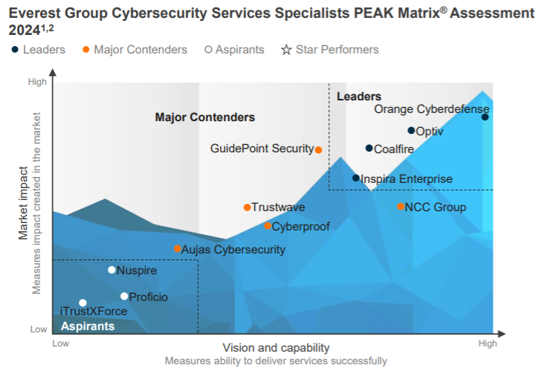

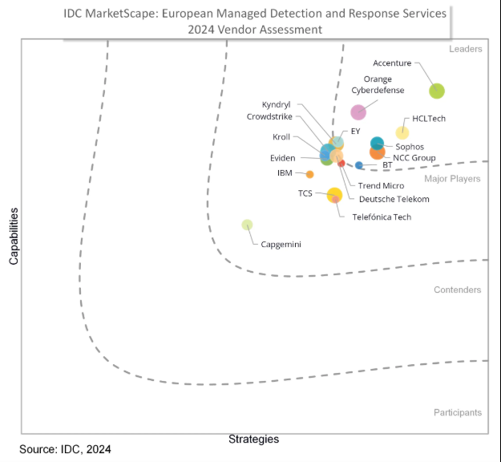
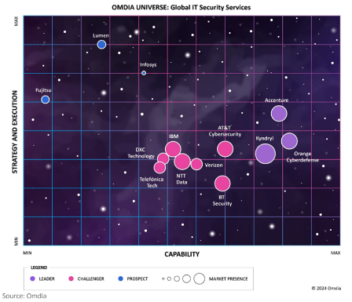

Change of perspective: an outside view
Omdia sees Orange Cyberdefense as one of the leading provider of global IT security services
IDC Positioned Orange Cyberdefense as leading provider of Managed Detection and Response in Europe
The Everest Group has recognized Orange Cyberdefense in its 2024 PEAK Matrix Assessment as leading provider of cybersecurity services

Slide 21





We strive for the highest standards of excellence. But it is not only our word that can be relied upon.
Gartner lists Orange Cyberdefense as a representative vendor in the Market Guide for Managed Detection and Response, Managed Security Services, Digital Forensics & Incident Response, Threat Intelligence and Operational Technology Security.
Omdia sees Orange Cyberdefense as one of the leading providers of global IT security services: "The provider has demonstrated considerable commitment, strategic vision and solution expertise in various end-to-end security service categories such as cloud, endpoint, OT, SASE, infrastructure and security intelligence."
Forrester ranks Orange Cyberdefense as a leader. According to the Forrester report, "Orange Cyberdefense delights its customers with high-quality technical services. Orange Cyberdefense is building its capabilities in cloud security and managed detection and response."
IDC positions Orange Cyberdefense in the "Leaders" category in the IDC Marketscape: European Managed Detection and Response Services 2024 Vendor Assessment. "Orange Cyberdefense offers a comprehensive range of managed and professional security services and can help companies to comprehensively mitigate cybersecurity risks."
Everest Group has recognized Orange Cyberdefense as a leader in managed threat detection. In the study, Everest Group evaluates 27 MDR service providers worldwide that are listed in the MDR Services PEAK Matrix® Assessment.

Slide 22
















Product partners for our services
Security platforms
Elite Partner
Premier Partner
Innovator MSSP
Elite Partner
Vulnerability, Threat & Exposure Management
Detection & Response
SASE & ZTNA
OT Security
Data Security

Slide 23









These companies trust us

Slide 24



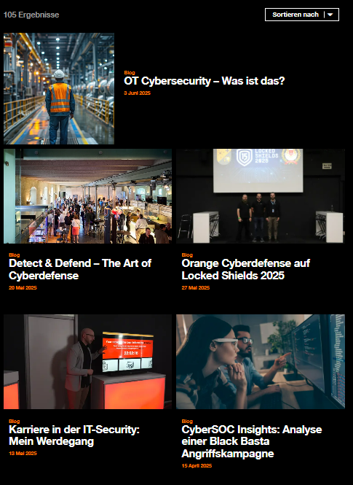
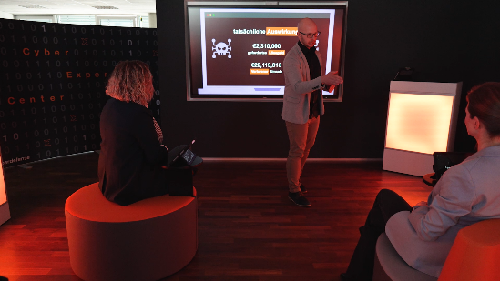
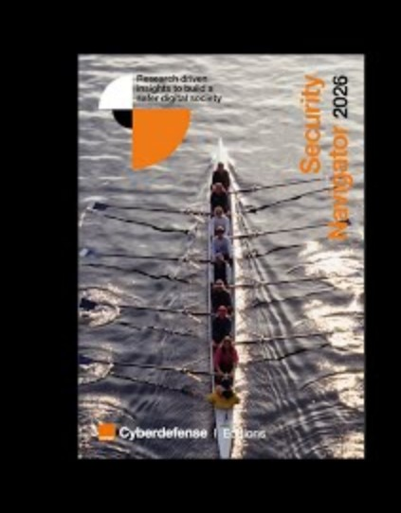
More Orange Cyberdefense
Security
Navigator 2026
Available now!
orangecyberdefense.com/de/security-navigator

